Slide 1
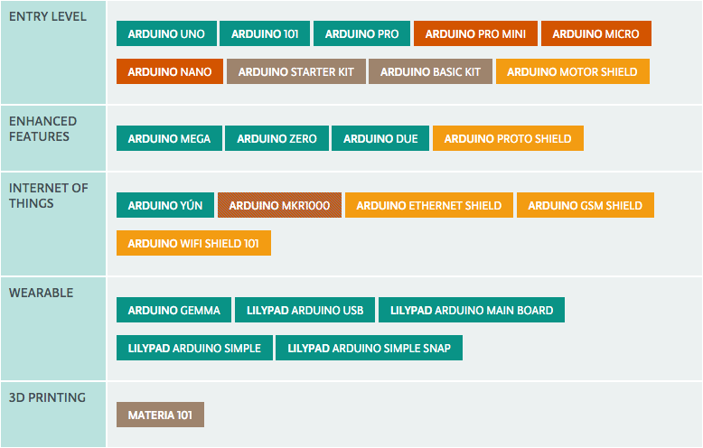
Catergories of Arduino Boards

Slide 2
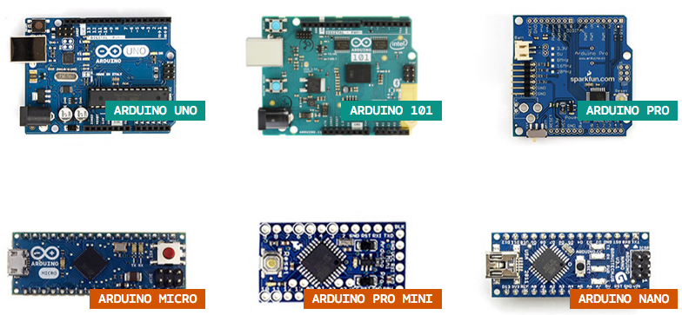
Entry Level Arduino Boards
Easy to use and ready to power your first creative projects. These boards and modules are the best to start learning and tinkering with electronics and coding.

Slide 3
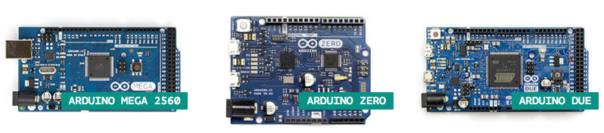
Enhanced Arduino Boards
Experience the excitement of more complex projects choosing one of the boards with advanced functionalities, or faster performances.

Slide 4
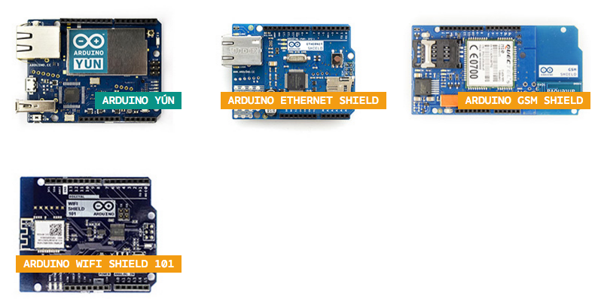
Internet of Things
Arduino Boards
Make connected devices easily with one of these IoT products and open your creativity with the opportunities of the world wide web.

Slide 5
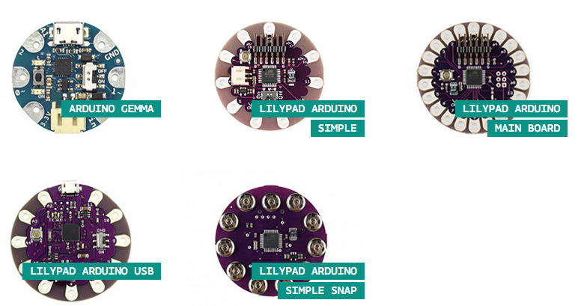
Wearable Arduino Boards
Add smartness to your soft projects and discover the magic of sewing the power of electronics directly to textiles.

Slide 6
Wearable Arduino Boards
Add smartness to your soft projects and discover the magic of sewing the power of electronics directly to textiles.

Slide 7
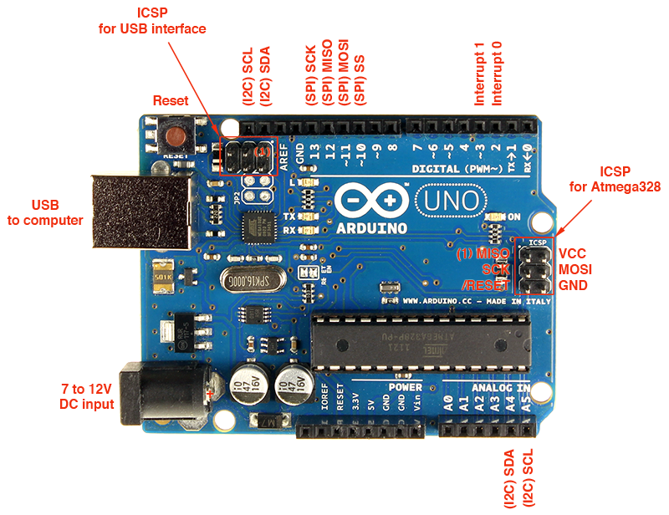
Arduino UNO

Slide 8
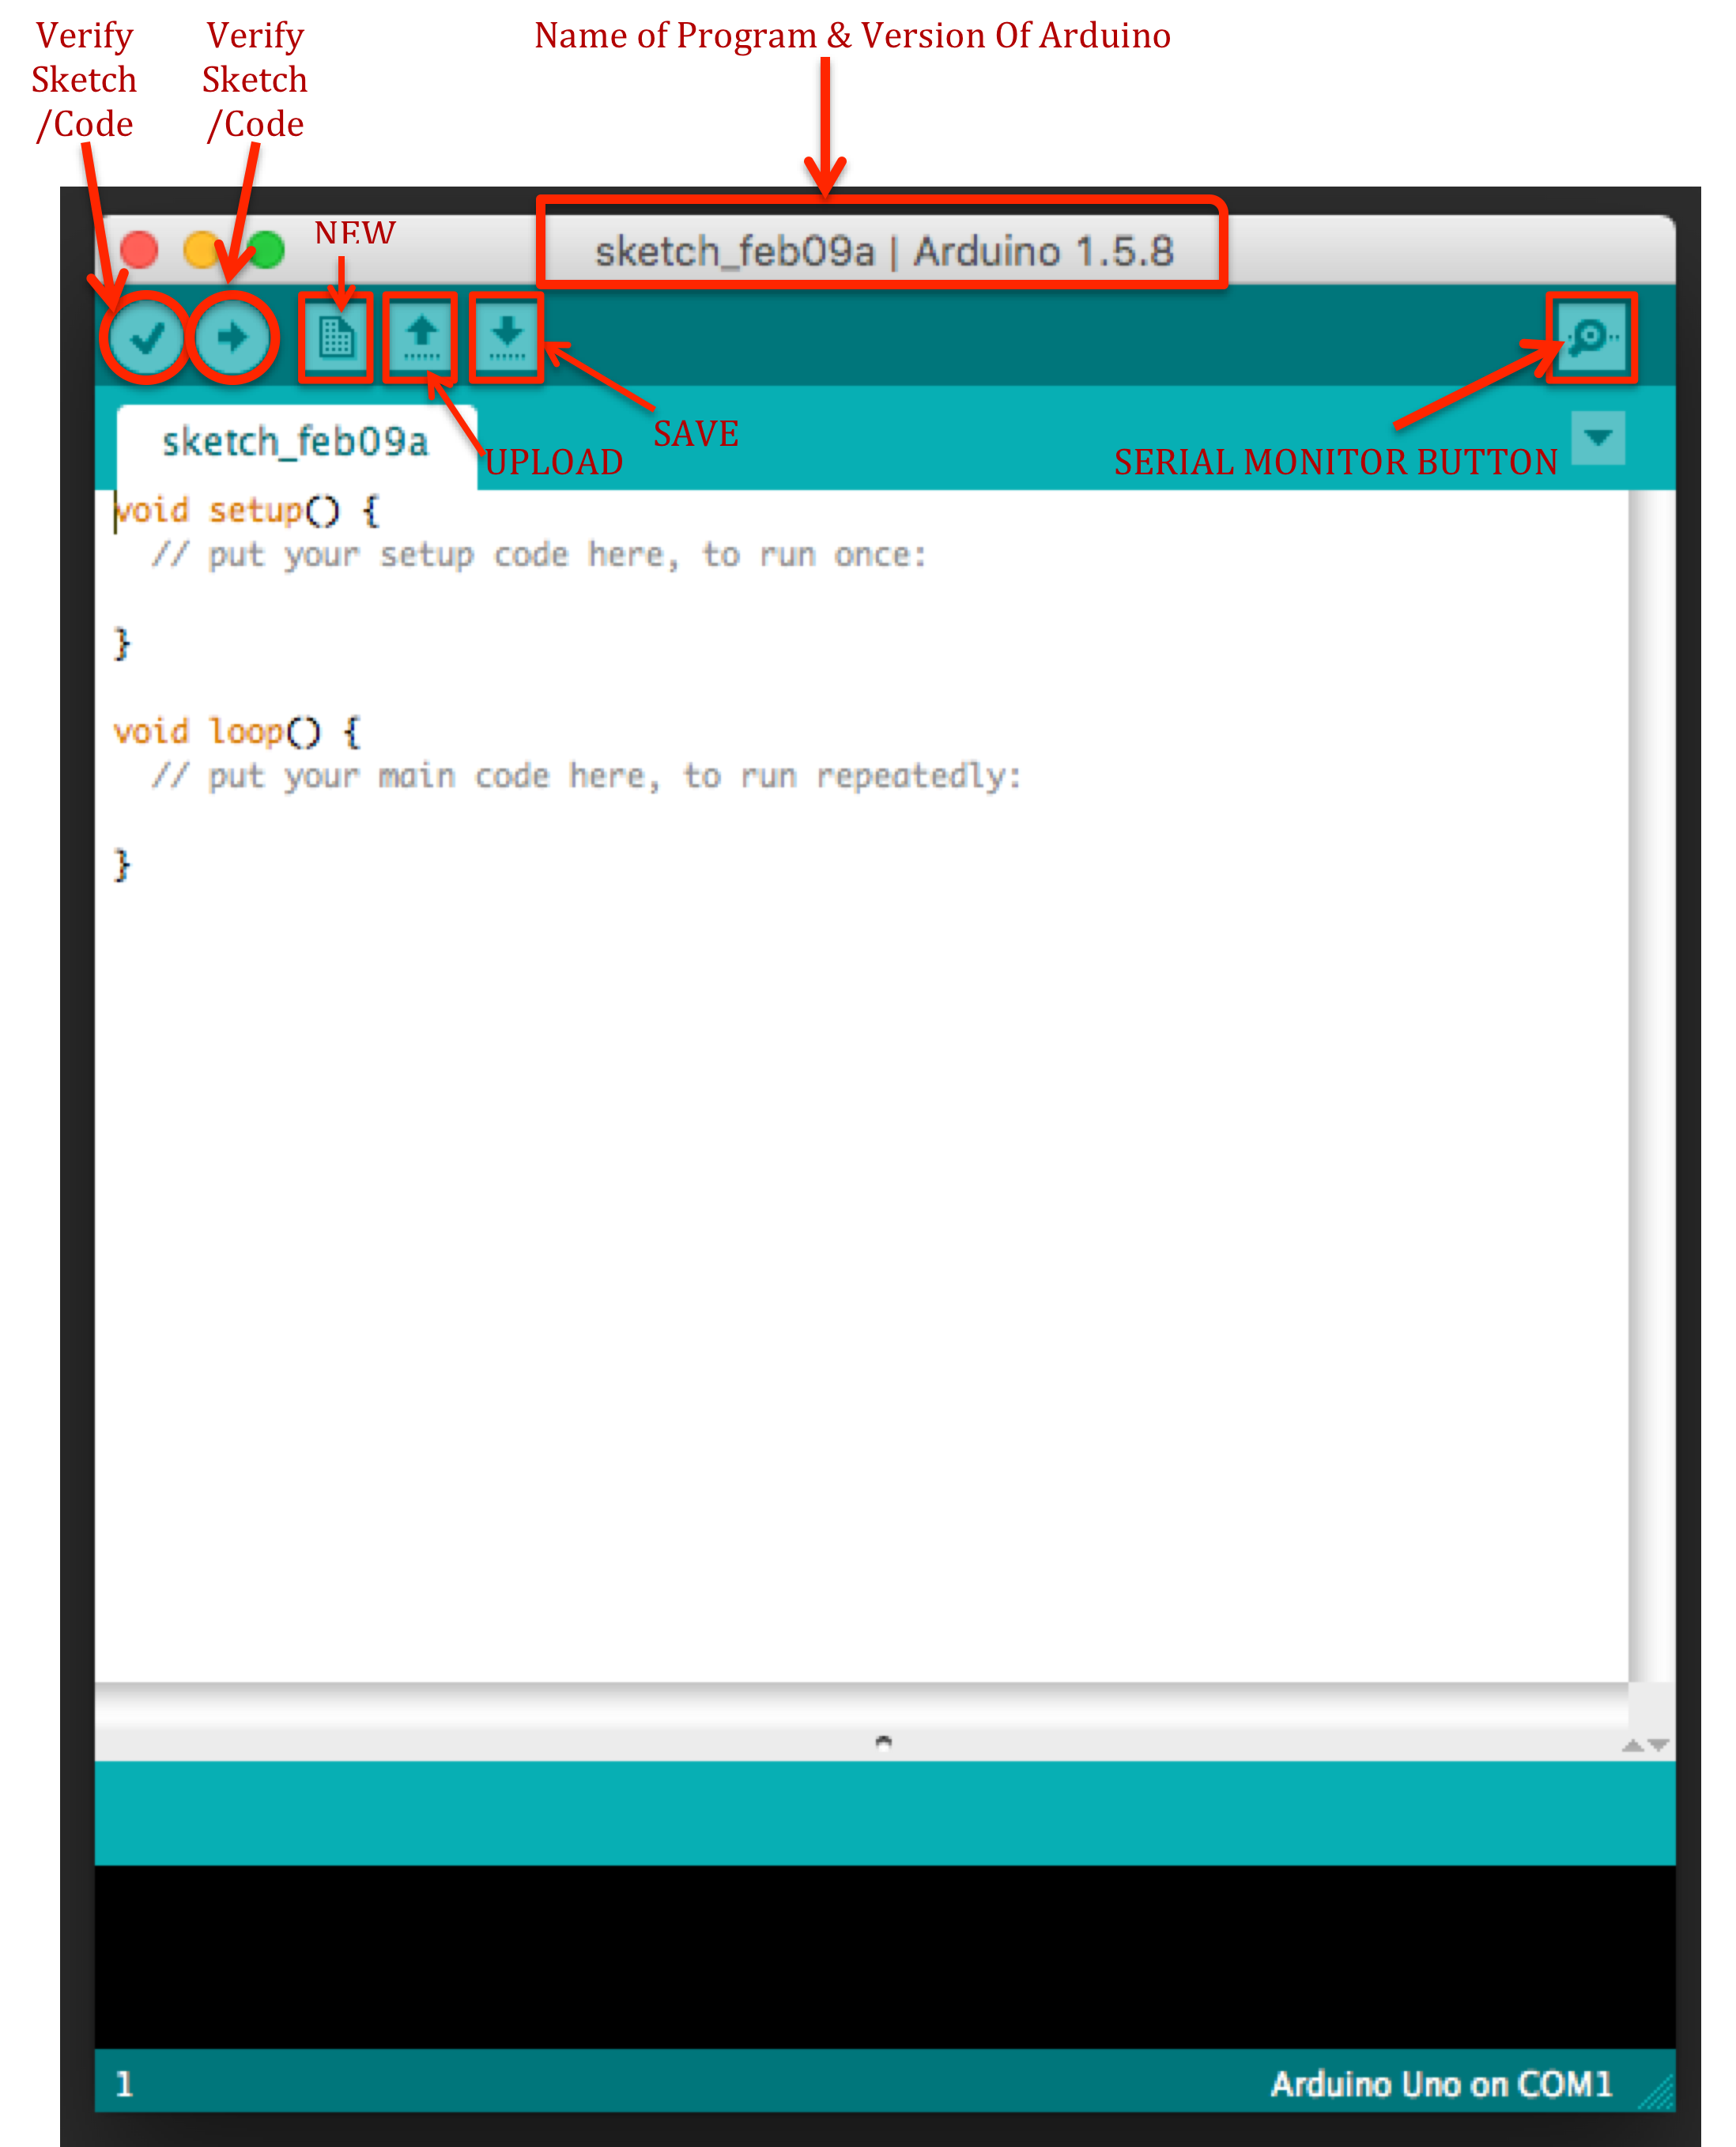
Arduino IDE
INTERFACE

Slide 9
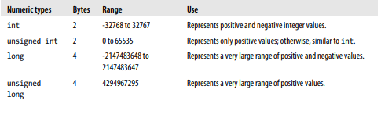
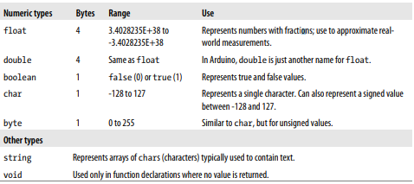
Data Types

Slide 10
Volatile
volatile is a keyword known as a variable qualifier, it is usually used before the datatype of a variable, to modify the way in which the compiler and subsequent program treats the variable.
Declaring a variable volatile is a directive to the compiler. The compiler is software which translates your C/C++ code into the machine code, which are the real instructions for the Atmega chip in the Arduino.
Specifically, it directs the compiler to load the variable from RAM and not from a storage register, which is a temporary memory location where program variables are stored and manipulated. Under certain conditions, the value for a variable stored in registers can be inaccurate.
A variable should be declared volatile whenever its value can be changed by something beyond the control of the code section in which it appears, such as a concurrently executing thread. In the Arduino, the only place that this is likely to occur is in sections of code associated with interrupts, called an interrupt service routine.

Slide 11
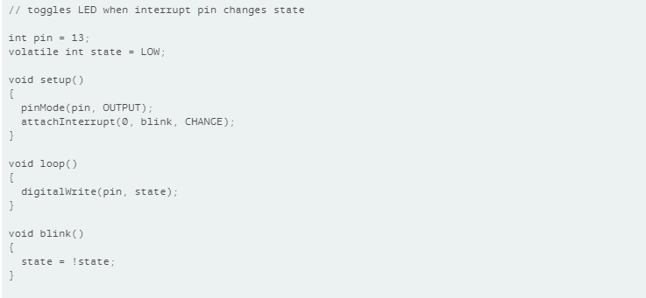
Volatile/Example

Slide 12
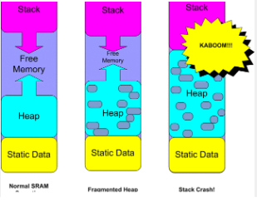
Memory manage techniques
SRAM is the most precious memory commodity on the Arduino. Although SRAM shortages are probably the most common memory problems on the Arduino. They are also the hardest to diagnose. If your program is failing in an otherwise inexplicable fashion, the chances are good you have crashed the stack due to a SRAM shortage.
There are a number of things that you can do to reduce SRAM usage.

Slide 13
Memory manage techniques
Use compiler constants rather than constant variables
In general, all constants should be compiler constants and not defined as variables.
const float pi = 3.14
will use 4 bytes where as
#define pi 3.14
uses zero bytes.
For example:
#define one 1
Here the constant "one" has no data type. To overcome this you can include a data-type as follows:
#define one (uint8_t)1

Slide 14


Memory manage techniques
F() Those Strings!
Literal strings are repeat memory offenders. First they take up space in the program image in Flash, then they are copied to SRAM at startup as static variables. This is a horrible waste of SRAM since we will never be writing to them. F() macro is a solution to this problem. The F() macro tells the compiler to keep your strings in PROGMEM. All you have to do is to enclose the literal string in the F() macro. For example, replacing this:
with this:
Will save you 180 bytes of SRAM!

Slide 15
Memory manage techniques
Reserve() your strings
The Arduino string library allows you to reserve buffer space for a string with the reserve() function. The idea is you can prevent String from fragmenting the heap by using reserve(num) to pre-allocate memory for a String that grows.
With the memory already allocated, String doesn't need to call realloc() if the string grows in length. In most usages, lots of other little String objects are used temporarily as you perform these operations, forcing the new string allocation to a new area of the heap and leaving a big hole where the previous one was (memory fragmentation). Usually all you need to do is use reserve() on any long-lived String objects that you know will be increasing in length as you process text.
You can do better with C strings, but if you just follow these guidelines for String objects, they work nearly as efficiently and using them is so much easier.

Slide 16
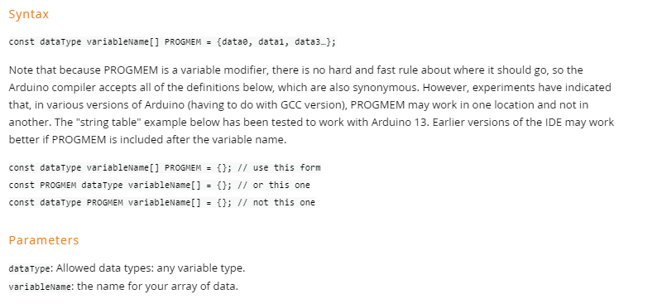
Memory manage techniques
Move constant data to PROGMEM.
Data items declared as PROGMEM do not get copied to SRAM at startup.
https://www.avrfreaks.net/forum/tut-c-gcc-and-progmem-attribute?name=PNphpBB2&file=viewtopic&t=38003

Slide 17
Memory manage techniques
Global & Static Variables
Global and Static variables are the first things loaded into SRAM. They push the start of the heap upward toward the stack and they will occupy this space for all eternity.
Dynamic Allocations
Dynamicaly allocated objects and data cause the heap to grow toward the stack. Unlike Global and Static variables, these variables can be de-allocated to free up space. But this does not necessarily cause the heap to shrink! If there is other dynamic data above it in the heap, the top of the heap will not move. When the heap is full of holes like swiss cheese we call it a "fragmented heap".
Local Variables
Every function call creates a stack frame that makes the stack grow toward the heap. Each stack frame will contain:All parameters passed to the function
All local variables declared in the function.
This data is usable within the function, but the space is 100% reclaimed when the function exits!
https://www.avrfreaks.net/forum/tut-c-gcc-and-progmem-attribute?name=PNphpBB2&file=viewtopic&t=38003

